Slide 1
Module1_Introduction
Reference: “OPERATING SYSTEM CONCEPTS”, ABRAHAM SILBERSCHATZ, PETER BAER GALVIN, GREG GAGNE , Wiley publications.

Slide 2
What is an Operating System?
A program that acts as an intermediary between a user of a computer and the computer hardware.
Operating system goals:
Execute user programs and make solving user problems easier.
Make the computer system convenient to use.
Use the computer hardware in an efficient manner.

Slide 3
Computer System Structure
Computer system can be divided into four components
Hardware – provides basic computing resources
CPU, memory, I/O devices
Operating system
Controls and coordinates use of hardware among various applications and users
System and Application programs – define the ways in which the system resources are used to solve the computing problems of the users
Word processors, compilers, web browsers, database systems, video games
Users
People, machines, other computers

Slide 4
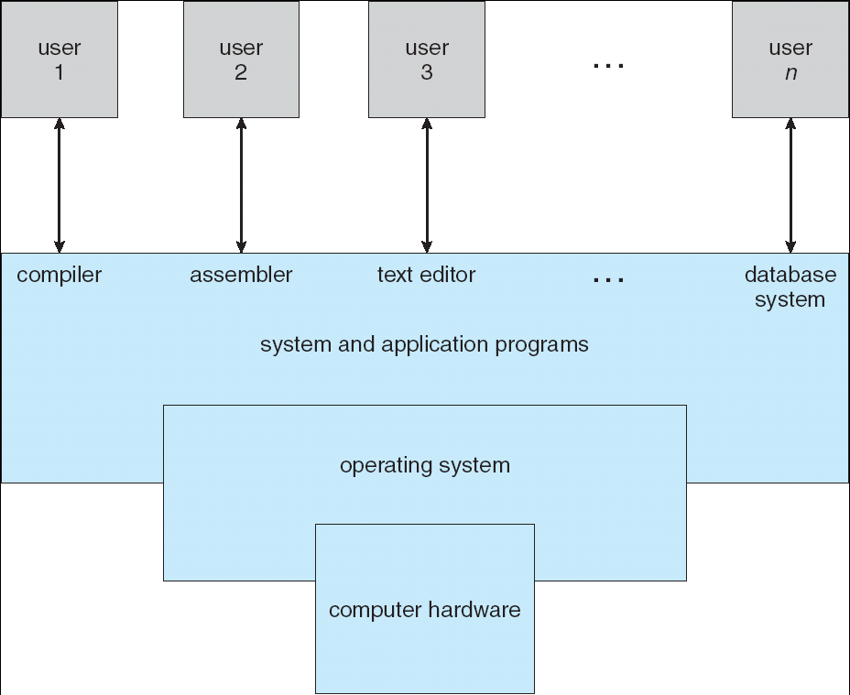
Four Components of a Computer System

Slide 5
What Operating Systems Do
The operating system controls the hardware and coordinates its use among the various application programs for the various users.
We can also view a computer system as consisting of hardware, software, and data.
The operating system provides the means for proper use of these resources in the operation of the computer system.
An operating system is similar to a government. Like a government, it performs no useful function by itself. It simply provides an environment within which other programs can do useful work.
To understand more fully the operating system's role, the concept of operating systems is explored in two viewpoints:
The user view
The system view

Slide 6
User View
The user's view of the computer varies according to the interface being used
Single user computers (e.g., PC, workstations). Such systems are designed for one user to monopolize its resources.
The goal is to maximize the work (or play) that the user is performing. the operating system is designed mostly for ease of use and good performance.
Multi user computers (e.g., mainframes, computing servers). These users share resources and may exchange information.
The operating system in such cases is designed to maximize resource utilization -- to assure that all available CPU time, memory, and I/O are used efficiently and that no individual users takes more than their fair share.

Slide 7
User View (Cont’d)
Handheld computers (e.g., smartphones and tablets). The user interface for mobile computers generally features a touch screen. The systems are resource poor, optimized for usability and battery life.
Embedded computers (e.g., computers in home devices and automobiles) The user interface may have numeric keypads and may turn indicator lights on or off to show status. The operating systems are designed primarily to run without user intervention.

Slide 8
System View
From the computer's point of view, the operating system is the program most intimately involved with the hardware. There are two different views:
The operating system is a resource allocator
Manages all resources
Decides between conflicting requests for efficient and fair resource use
The operating systems is a control program
Controls execution of programs to prevent errors and improper use of the computer

Slide 9
Operating System Definition
OS is a resource allocator
Manages all resources
Decides between conflicting requests for efficient and fair resource use
OS is a control program
Controls execution of programs to prevent errors and improper use of the computer

Slide 10
Operating System Definition (Cont’d)
Operating systems exist to offer a reasonable way to solve the problem of creating a usable computing system.
The fundamental goal of computer systems is to execute user programs and to make solving user problems easier.
Since bare hardware alone is not particularly easy to use, application programs are developed.
These programs require certain common operations, such as those controlling the I/O devices.
The common functions of controlling and allocating resources are brought together into one piece of software: the operating system.

Slide 11
Operating System Definition (Cont.)
No universally accepted definition
A simple viewpoint is that it includes everything a vendor ships when you order the operating system. The features that are included vary greatly across systems:
Some systems take up less than a megabyte of space and lack even a full-screen editor
Some systems require gigabytes of space and are based entirely on graphical windowing systems.
“The one program running at all times on the computer” is the OS kernel.
Along with the kernel, there are two other types of programs:
System programs, which are associated with the operating system but are not necessarily part of the kernel.
Application programs, which include all programs not associated with the operation of the system.
Kernel is the central core/ fundamental part of modern OS

Slide 12
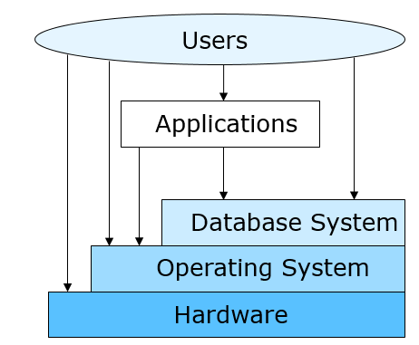
Evolution of Computer Systems

Slide 13
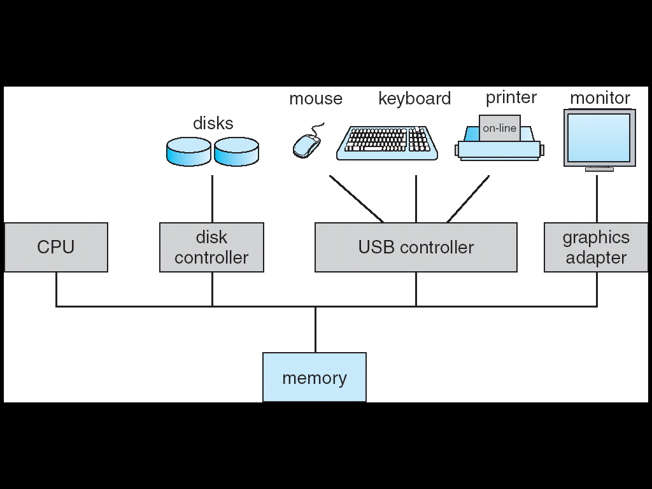
Computer System Organization
Computer-system
One or more CPUs, device controllers connect through common bus providing access to shared memory
Each device controller is in charge of a specific type of device (for example, disk drives, audio devices, or video displays). Each device controller has a local buffer.
CPU moves data from/to main memory to/from local buffers.
The CPU and the device controllers can execute in parallel, competing for memory cycles. To ensure orderly access to the shared memory, a memory controller synchronizes access to the memory.
Device socket is connected to device controller
Each device controller has an equivalent device driver
Concurrent execution of CPUs and devices competing for memory cycles

Slide 14
Computer-System Operation
I/O devices and the CPU can execute concurrently.
Each device controller is in charge of a particular device type.
Each device controller has a local buffer.
CPU moves data from/to main memory to/from local buffers
I/O is from the device to local buffer of controller.
Device controller informs CPU that it has finished its operation by causing an interrupt.

Slide 15
Computer Startup
Bootstrap program is loaded at power-up or reboot
Typically stored in ROM /EEPROM/Flash memory, generally known as firmware
Initializes all aspects of system
Loads operating system kernel and starts execution

Slide 16
Interrupts
There are two types of interrupts:
Hardware Interrupt -- a device may trigger an interrupt by sending a signal to the CPU, usually by way of the system bus.
Software Interrupt -- a program may trigger an interrupt by executing a special operation called a system call.
A software-generated interrupt (sometimes called trap or exception) is caused either by an error (e.g., divide by zero) or a user request (e.g., an I/O request).
An operating system is interrupt driven.

Slide 17
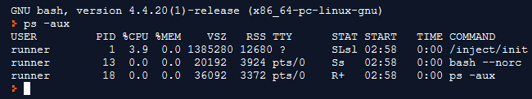
Interrupts
Once the kernel is loaded and executing, it can start providing services to the system and its users.
Some services are provided outside of the kernel, by system programs that are loaded into memory at boot time to become system processes, or system daemons that run the entire time the kernel is running.
On UNIX, the first system process is init and it starts many other daemons. Once this phase is complete, the system is fully booted, and the system waits for some event to occur.
The occurrence of an event is usually signaled by an interrupt.

Slide 18
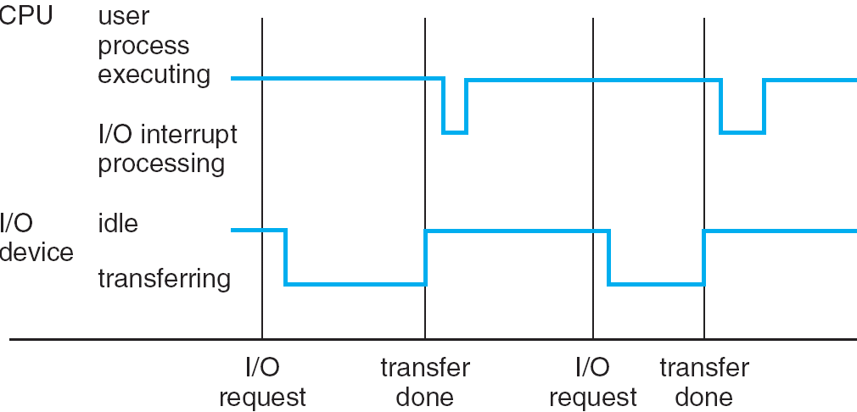
Interrupt Handling
When an interrupt occurs, the operating system
preserves the state of the CPU by storing the registers and the program counter
Determines which type of interrupt has occurred and transfers control to the appropriate interrupt-service routine (ISR)
An interrupt-service routine is a collection of routines (modules), each of which is responsible for handling one particular interrupt (e.g., from a printer, from a disk)
The transfer is generally through the interrupt vector, which contains the addresses of all the service routines
Interrupt architecture must save the address of the interrupted instruction.
Incoming interrupts are disabled while another interrupt is being processed to prevent a loss of interrupt.
A trap is a software-generated interrupt caused either by an error or a user request.
An operating system is interrupt driven.

Slide 19
Interrupt Timeline

Slide 20
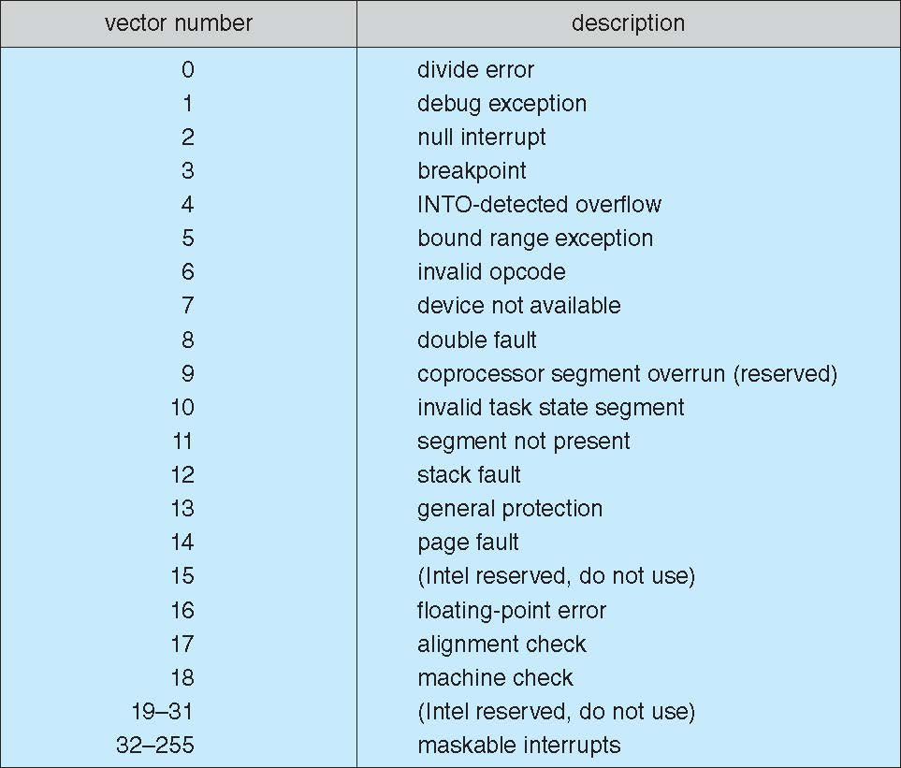
Intel Pentium processor event-vector table

Slide 21
Storage Structure
Main memory – the only large storage media that the CPU can access directly
Random access
volatile
Secondary storage – extension of main memory that provides large nonvolatile storage capacity
Hard disks – rigid metal or glass platters covered with magnetic recording material
Disk surface is logically divided into tracks, which are subdivided into sectors.
The disk controller determines the logical interaction between the device and the computer.
Solid-state disks – faster than hard disks, nonvolatile
Tertiary storage
Magnetic Tapes
Optical Disks

Slide 22
Storage Definition
The basic unit of computer storage is the bit. A bit can contain one of two values, 0 and 1. All other storage in a computer is based on collections of bits.
A byte is 8 bits, and on most computers it is the smallest convenient chunk of storage.
A less common term is word, which is a given computer architecture’s native unit of data. A word is made up of one or more bytes.

Slide 23
Storage Definition (Cont.)
Computer storage is generally measured and manipulated in bytes and collections of bytes.
A kilobyte, or KB, is 1,024 bytes
a megabyte, or MB, is 1,024² bytes
a gigabyte, or GB, is 1,024³ bytes
a terabyte, or TB, is 1,024⁴ bytes
a petabyte, or PB, is 1,024⁵ bytes
exabyte, zettabyte, yottabyte
Computer manufacturers often round off these numbers and say that a megabyte is 1 million bytes and a gigabyte is 1 billion bytes. Networking measurements are an exception to this general rule; they are given in bits (because networks move data a bit at a time).

Slide 24
Storage Hierarchy
Storage systems are organized in hierarchy.
Speed
Cost
Volatility
Caching – copying information into faster storage system; main memory can be viewed as a last cache for secondary storage.

Slide 25
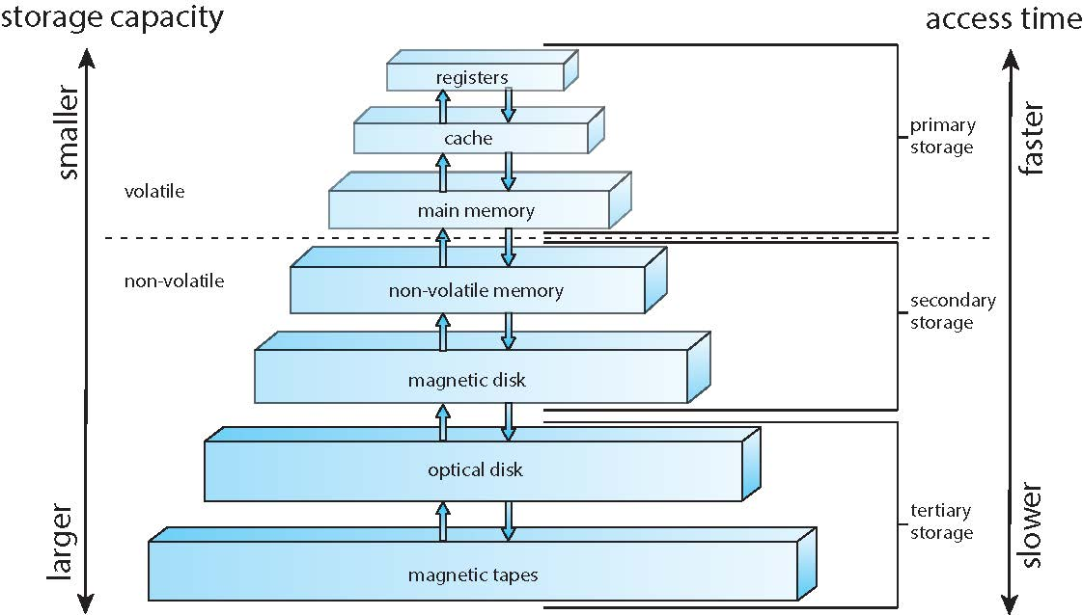
Storage-Device Hierarchy

Slide 26
Caching
Important principle, performed at many levels in a computer (in hardware, operating system, software)
Information in use is copied from slower to faster storage temporarily
Faster storage (cache) checked first to determine if information is there
If it is there, information is used directly from the cache (fast)
If not, data is copied to cache and used from there
Cache is smaller than storage being cached
Cache management: important design problem
Cache size and replacement policy

Slide 27
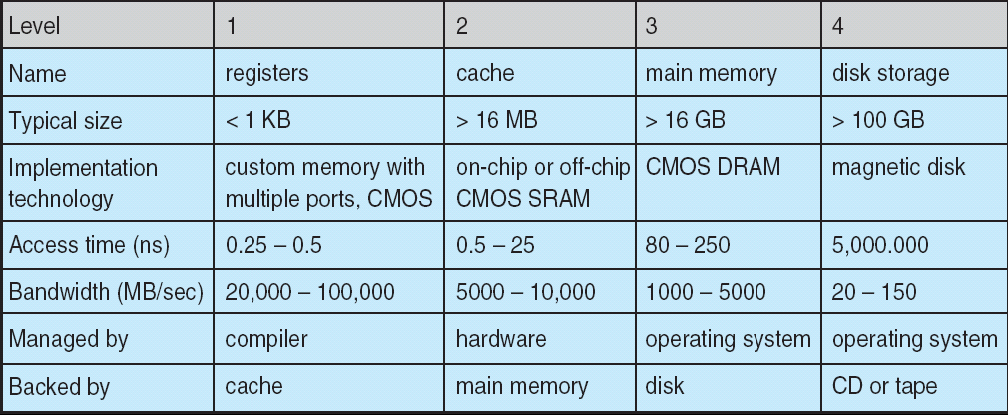
Performance of Various Levels of Storage
Movement between levels of storage hierarchy can be explicit or implicit

Slide 28
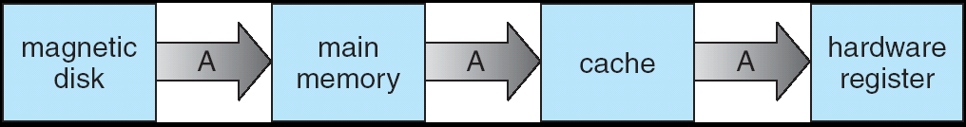
Migration of Integer A from Disk to Register
Multitasking environments must be careful to use most recent value, no matter where it is stored in the storage hierarchy
Multiprocessor environment must provide cache coherency in hardware such that all CPUs have the most recent value in their cache
Distributed environment -situation is even more complex
Several copies of a datum can exist

Slide 29
I/O Structure
A general-purpose computer system consists of CPUs and multiple device controllers that are connected through a common bus.
Each device controller is in charge of a specific type of device. More than one device may be attached. For instance, seven or more devices can be attached to the small computer-systems interface (SCSI) controller.
A device controller maintains some local buffer storage and a set of special-purpose registers.
The device controller is responsible for moving the data between the peripheral devices that it controls and its local buffer storage.
Typically, operating systems have a device driver for each device controller. This device driver understands the device controller and provides the rest of the operating system with a uniform interface to the device.
Device Driver for each device controller to manage I/O
Provides uniform interface between controller and kernel

Slide 30
I/O Structure (Cont’d )
To start an I/O operation, the device driver loads the appropriate registers within the device controller.
The device controller, in turn, examines the contents of these registers to determine what action to take (such as “read” a character from the keyboard).
The controller starts the transfer of data from the device to its local buffer. Once the transfer of data is complete, the device controller informs the device driver via an interrupt that it has finished its operation.
The device driver then returns control to the operating system, possibly returning the data or a pointer to the data if the operation was a read.
For other operations, the device driver returns status information.

Slide 31
I/O Structure Cont’d
After I/O starts, control returns to user program only upon I/O completion.
Wait instruction idles the CPU until the next interrupt
Wait loop
one I/O request may be outstanding at a time, no simultaneous I/O processing.
After I/O starts, control returns to user program without waiting for I/O completion.
Device-status table contains entry for each I/O device indicating its type, address, and state.
Operating system indexes into I/O device table to determine device status and to modify table entry to include interrupt.

Slide 32
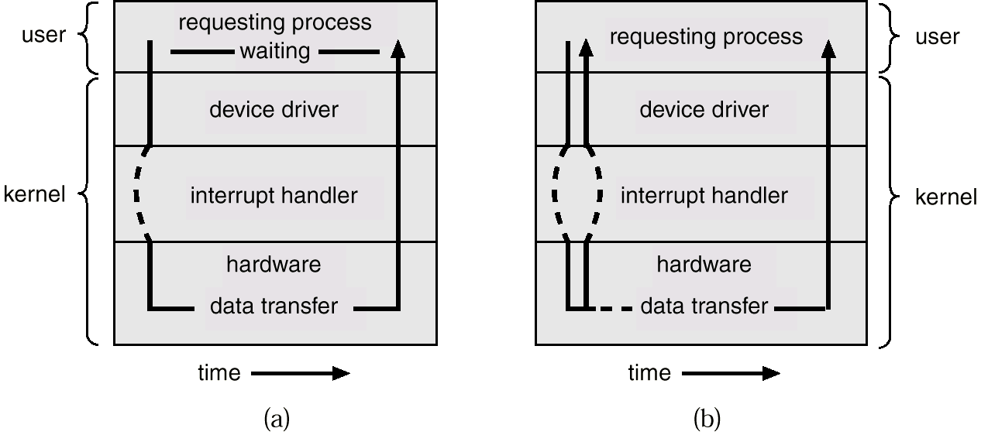
Two I/O Methods
Synchronous
Asynchronous

Slide 33
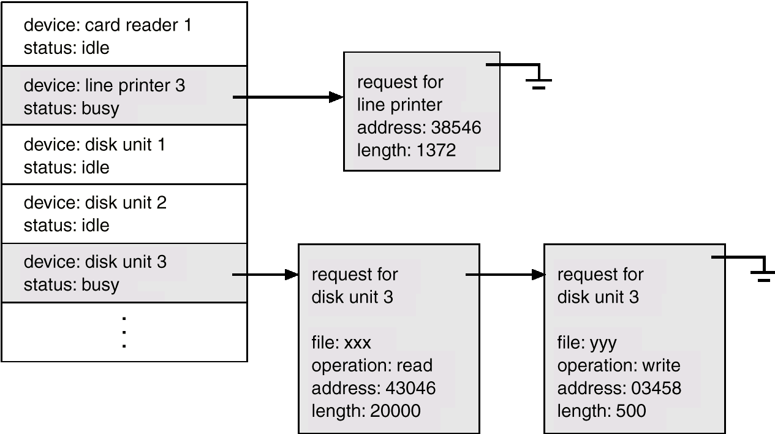
Device-Status Table
Device-status table contains entry for each I/O device indicating its type, address, and state.
Operating system indexes into I/O device table to determine device status and to modify table entry to include interrupt

Slide 34
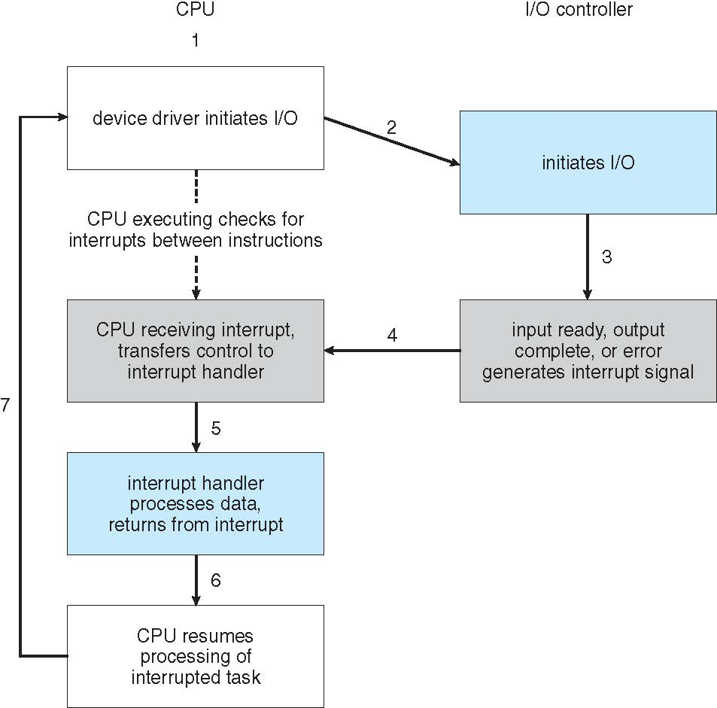
Interrupt-driven I/O cycle

Slide 35
Direct Memory Access Structure
Interrupt-driven I/O is fine for moving small amounts of data but can produce high overhead when used for bulk data movement such as disk I/O.
To solve this problem, direct memory access (DMA) is used.
After setting up buffers, pointers, and counters for the I/O device, the device controller transfers an entire block of data directly to or from its own buffer storage to memory, with no intervention by the CPU.
Only one interrupt is generated per block, to tell the device driver that the operation has completed. While the device controller is performing these operations, the CPU is available to accomplish other work.
Some high-end systems use switch rather than bus architecture. On these systems, multiple components can talk to other components concurrently, rather than competing for cycles on a shared bus. In this case, DMA is even more effective.

Slide 36
Direct Memory Access Structure (Cont’d)
Used for high-speed I/O devices, able to transmit information at close to memory speeds.
Device controller transfers blocks of data from buffer storage directly to main memory without CPU intervention.
Only one interrupt is generated per block, rather than the one interrupt per byte.

Slide 37
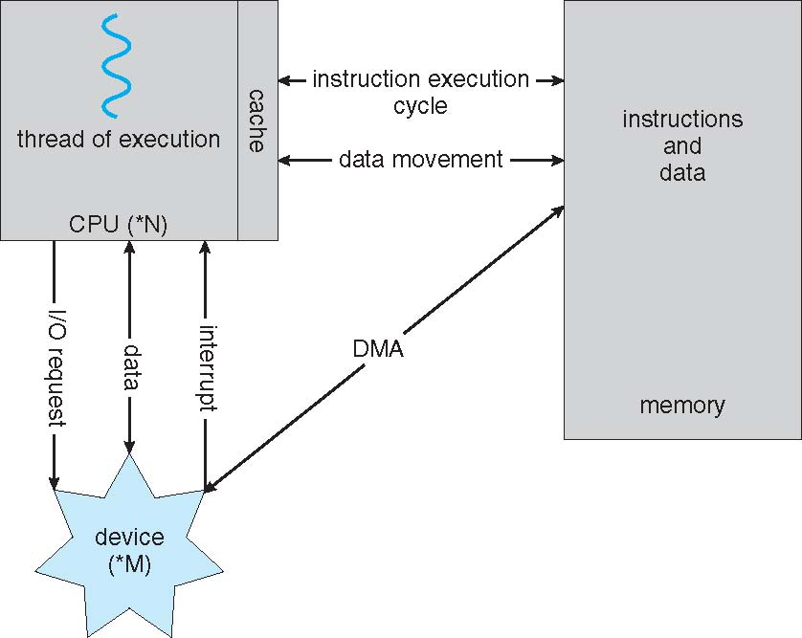
Working of a Modern Computer
A Von Neumann architecture and a depiction of the interplay of all components of a computer system.

Slide 38
Modes of Operation
A mechanism that allows the OS to protect itself and other system components
Two modes:
User mode
Kernel mode
Mode bit (0 or 1) provided by hardware
Provides ability to distinguish when system is running user code or kernel code
Some instructions designated as privileged, only executable in kernel mode
Systems call by a user asking the OS to perform some function changes from user mode to kernel mode.
Return from a system call resets the mode to user mode.
Dual-mode operation allows OS to protect itself and other system components
Software error or request creates exception or trap
Division by zero, request for operating system service
Other process problems include infinite loop, processes modifying each other or the operating system

Slide 39
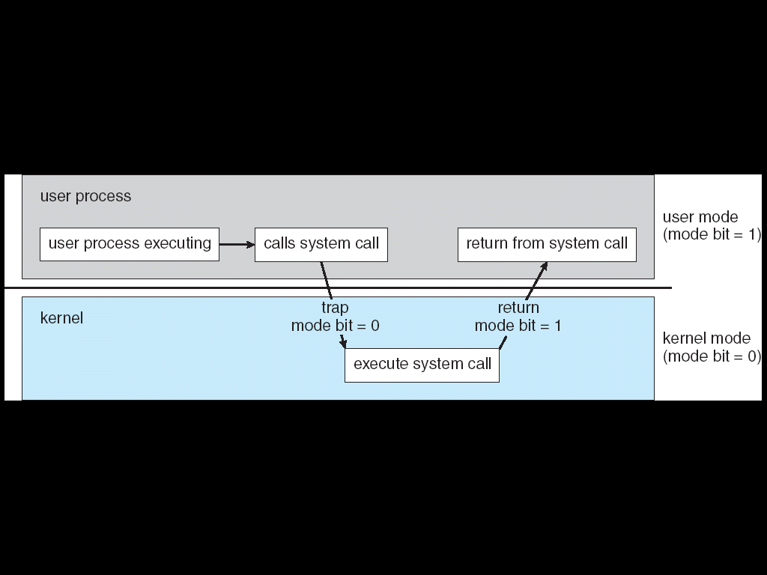
Transition from User to Kernel Mode

Slide 40
Timer
To prevent a process being in infinite loop (process hogging resources), a timer is used, which is a hardware device.
Timer is a counter that is decremented by the physical clock.
Timer is set to interrupt the computer after some time period
Operating system sets the counter (privileged instruction)
When counter reaches the value zero, and interrupt is generated.
The OS sets up the value of the counter before scheduling a process to regain control or terminate program that exceeds the allotted time.

Slide 41
Computer-System Architecture
Single general-purpose processor
Most systems have special-purpose processors as well
Multiprocessors systems
Also known as parallel systems, tightly-coupled systems
Advantages include:
Increased throughput
Economy of scale
Increased reliability – graceful-degradation/fault-tolerance
Two types:
Symmetric Multiprocessing – each processor performs all tasks
Asymmetric Multiprocessing – each processor is assigned a specific task.

Slide 42
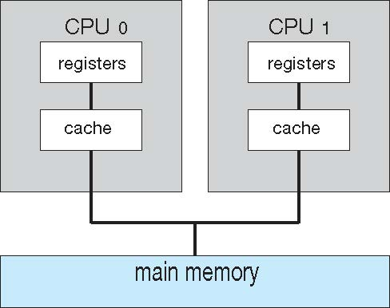
Symmetric Multiprocessing Architecture

Slide 43
Multicore Systems
Most CPU design now includes multiple computing cores on a single chip. Such multiprocessor systems are termed multicore.
Multicore systems can be more efficient than multiple chips with single cores because:
On-chip communication is faster than between-chip communication.
One chip with multiple cores uses significantly less power than multiple single-core chips, an important issue for laptops as well as mobile devices.
Multicore systems are multiprocessor systems, not all multiprocessor systems are multicore.

Slide 44
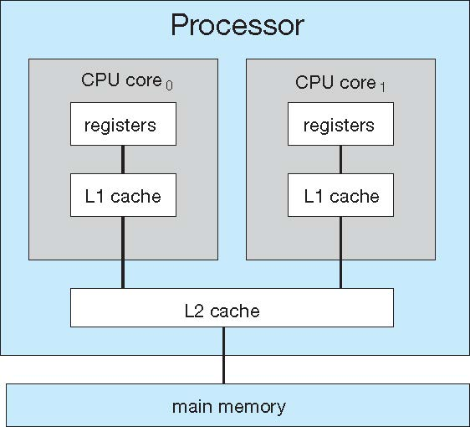
A dual-core with two cores placed on the same chip

Slide 45
Clustered Systems
Like multiprocessor systems, but multiple systems working together
Usually sharing storage via a storage-area network (SAN)
Provides a high-availability service which survives failures
Asymmetric clustering has one machine in hot-standby mode
Symmetric clustering has multiple nodes running applications, monitoring each other
Some clusters are for high-performance computing (HPC)
Applications must be written to use parallelization
Some have distributed lock manager (DLM) to avoid conflicting operations

Slide 46
Clustered Systems

Slide 47
Multiprogrammed System
Single user cannot keep CPU and I/O devices busy at all times
Multiprogramming organizes jobs (code and data) so CPU always has one to execute
A subset of total jobs in system is kept in memory
Batch systems:
One job selected and run via job scheduling
When it has to wait (for I/O for example), OS switches to another job
Interactive systems:
Logical extension of batch systems -- CPU switches jobs so frequently that users can interact with each job while it is running, creating interactive computing

Slide 48
Interactive Systems
Response time should be < 1 second
Each user has at least one program executing in memory. Such a program is referred to as a process
If several processes are ready to run at the same time, we need to have CPU scheduling.
If processes do not fit in memory, swapping moves them in and out to run
Virtual memory allows execution of processes not completely in memory

Slide 49
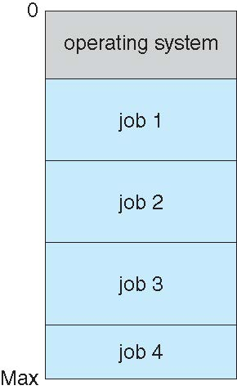
Memory Layout for Multiprogrammed System

Slide 50
Operating System Structure
Multiprogramming needed for efficiency
Single user cannot keep CPU and I/O devices busy at all times
Multiprogramming organizes jobs (code and data) so CPU always has one to execute
A subset of total jobs in system is kept in memory
One job selected and run via job scheduling
When it has to wait (for I/O for example), OS switches to another job
Timesharing (multitasking) is logical extension in which CPU switches jobs so frequently that users can interact with each job while it is running, creating interactive computing
Response time should be < 1 second
Each user has at least one program executing in memory process
If several jobs are ready to run at the same time  CPU scheduling
If processes don’t fit in memory, swapping moves them in and out to run
Virtual memory allows execution of processes not completely in memory

Slide 51
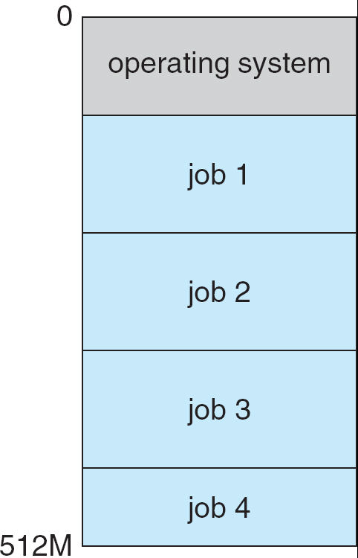
Memory Layout for Multiprogrammed System

Slide 52
Process Management
A process is a program in execution. It is a unit of work within the system. Program is a passive entity, process is an active entity.
Process needs resources to accomplish its task
CPU, memory, I/O, files
Initialization data
Process termination requires reclaim of any reusable resources
Single-threaded process has one program counter specifying location of next instruction to execute
Process executes instructions sequentially, one at a time, until completion
Multi-threaded process has one program counter per thread
Typically system has many processes, some user, some operating system running concurrently on one or more CPUs
Concurrency by multiplexing the CPUs among the processes / threads

Slide 53
Process Management Activities
The operating system is responsible for the following activities in connection with process management:
Creating and deleting both user and system processes
Suspending and resuming processes
Providing mechanisms for process synchronization
Providing mechanisms for process communication
Providing mechanisms for deadlock handling

Slide 54
Memory Management
All data in memory before and after processing
All instructions in memory in order to execute
Memory management determines what is in memory when
Optimizing CPU utilization and computer response to users
Memory management activities
Keeping track of which parts of memory are currently being used and by whom
Deciding which processes (or parts thereof) and data to move into and out of memory
Allocating and deallocating memory space as needed

Slide 55
Storage Management
OS provides uniform, logical view of information storage
Abstracts physical properties to logical storage unit - file
Each medium is controlled by device (i.e., disk drive, tape drive)
Varying properties include access speed, capacity, data-transfer rate, access method (sequential or random)
File-System management
Files usually organized into directories
Access control on most systems to determine who can access what
OS activities include
Creating and deleting files and directories
Primitives to manipulate files and dirs
Mapping files onto secondary storage
Backup files onto stable (non-volatile) storage media

Slide 56
Mass-Storage Management
Usually disks are used to store data that does not fit in main memory or data that must be kept for a “long” period of time.
Proper management is of central importance
Entire speed of computer operation hinges on disk subsystem and its algorithms
OS activities
Free-space management
Storage allocation
Disk scheduling
Some storage need not be fast
Tertiary storage includes optical storage, magnetic tape
Still must be managed
Varies between WORM (write-once, read-many-times) and RW (read-write)

Slide 57
I/O Subsystem
One purpose of OS is to hide peculiarities of hardware devices from the user
I/O subsystem responsible for
Memory management of I/O including
buffering (storing data temporarily while it is being transferred),
caching (storing parts of data in faster storage for performance),
spooling (the overlapping of output of one job with input of other jobs)
General device-driver interface
Drivers for specific hardware devices

Slide 58
Protection and Security
Protection – any mechanism for controlling access of processes or users to resources defined by the OS
Security – defense of the system against internal and external attacks
Huge range, including denial-of-service, worms, viruses, identity theft, theft of service
Systems generally first distinguish among users, to determine who can do what
User identities (user IDs, security IDs) include name and associated number, one per user
User ID then associated with all files, processes of that user to determine access control
Group identifier (group ID) allows set of users to be defined and controls managed, also associated with each process, file
Privilege escalation allows user to change to effective ID with more rights

Slide 59
Computing Environments
Traditional computer
Office environment
PCs connected to a network, terminals attached to mainframe or minicomputers providing batch and timesharing
Now portals allowing networked and remote systems access to same resources
Home networks
Used to be single system, then modems
Now firewalled, networked

Slide 60
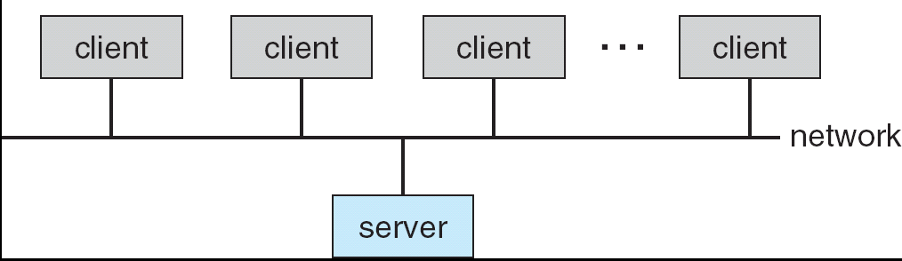
Computing Environments (Cont.)
Client-Server Computing
Dumb terminals supplanted by smart PCs
Many systems are now servers, responding to requests generated by clients
Compute-server provides an interface to client to request services (i.e. database)
File-server provides interface for clients to store and retrieve files

Slide 61
Peer-to-Peer Computing
A model of distributed system
P2P does not distinguish clients and servers
Instead all nodes are considered peers
May each act as client, server or both
Node must join P2P network
Registers its service with central lookup service on network, or
Broadcast request for service and respond to requests for service via discovery protocol
Examples include Napster and Gnutella

Slide 62
Web-Based Computing
Web has become ubiquitous
PCs are most prevalent devices
More devices are networked to allow web access
New category of devices to manage web traffic among similar servers: load balancers

